Slide 1
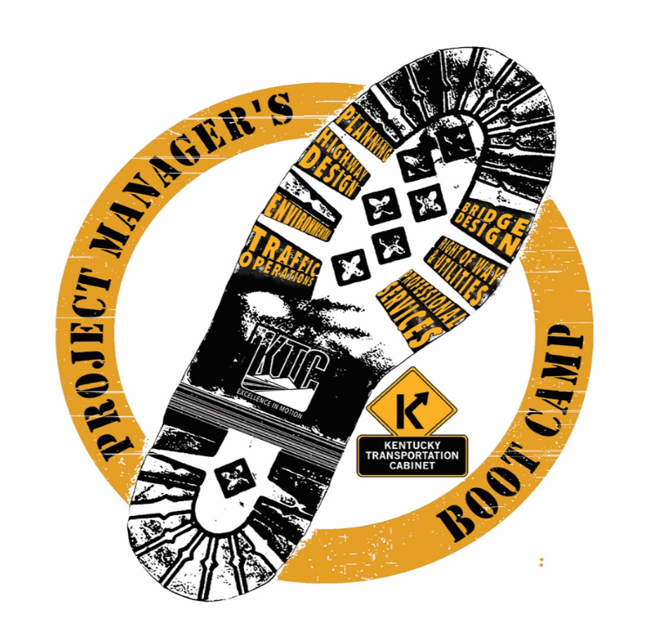
HIGHWAY DESIGN
What do Project Managers Need from the Division of Highway Design?
Full 8 Day Boot Camp
Spring 2015
Fall 2015
Fall 2016

Slide 2
Spring 2015

Slide 3
Submittal Process Technology
improved cmr
improve file management protocols
timely des review and approval
less cumbersome drainage submittal requirements
a single plan submittal requirements
self-populating databases
improved tracking system (des, pavement, drainage)
new program/project management software
electronic file exchange software (with consultants/contractors)
technology that works
Staff resources training
advanced pm training
cad workflow manual
additional survey training
hidug
full time constructability reviewers
more drainage staff
greater flexibility using statewide consultants

Slide 4
Fall 2015

Slide 5
funding constructability
quick review of funding rod
funding request tracking
clarify who is responsible for constructability review
constructability review after ji, not check prints
policy guidance/interpretation
timely responses to questions
improved technical support
cadd support
improved stp site
Technical guidance software support

Slide 6
Des approval Pavement design
des tracking
prompt review of dea
pavement review
pavement design approval
plan review and processing
Drainage review Plan Review
drainage design expertise
drainage review

Slide 7
Fall 2016

Slide 8
Letting Support Pavement Design Support
contract plan set
project checklist
pavement design (assistance and/or approval)
Reference Materials technical expertise
expertise on design components
survey support
des support
how flexible is enough? how much?
technical support
standard drawings
cad standards
electronic standard drawings
reference materials
design manual
updated bid codes

Slide 9
Improved training opportunities Drainage Design Support
more information on survey techniques
ask staff what training they need
drainage folder: input and coordination
drainage review approval
early value engineering involvement
more value engineering studies
Value Engineering support Timely Communication
feedback/communication
sharing of other division memos
consistency
bird dog central office project actions
inter-division support
timely des approvals

Slide 10
Technical Support
projectwise
computer support
better computers to handle lidar
project support
office resource links
technical assistance

